Slide 1
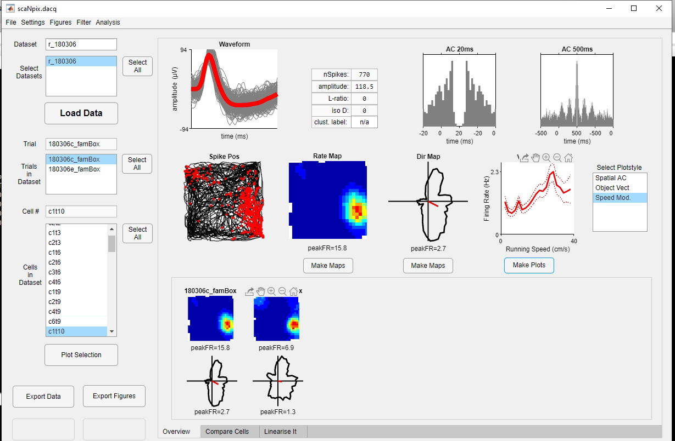
Waveforms
By default 250 single
Waveforms and mean
Short lag AC
(default=20ms)
Long lag AC
(default=500ms)
Dataset IDs
Load data from raw
Variable data plot:
Select Type of plot in
List box next to it
Trial IDs
Cell IDs
Make maps/plots
Plot maps for all
currently selected
trials/cells
Rate maps/polar plots
for all trials in dataset
Save GUI state
Save figures generated
with GUI
GUI window tabs

Slide 2
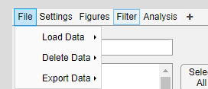
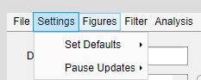
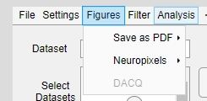
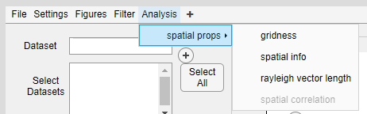
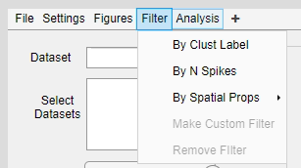
Load data; either from raw
or GUI state
Delete selected datasets/
trials/cells
Save GUI state; either current
selection or whole data
Set Params for GUI
Pause updates for any
plots in overview tab
Save figures generated with
GUI as PDF; either all or a
custom selection
Generate data type specific
plots
Fetch
Filter data

